Slide 1

Mary A. Marion
Personal Statement
Career Milestones

Slide 2
Introduction
My name is Mary A. Marion. I am an applied statistician who applies mathematical theory to my projects.
My tools include a statistics library and state of the art computer setup.

Slide 3
Academic Credentials
Nickname | School | Area
RIT | Rochester Institute of Technology College of Science | M.S. Applied Statistics 2023
KSU | Kansas State University College of Science | Statistics
UVA | The University of Virginia College of Arts & Sciences | Statistics
VT | Virginia Tech College of Science | Statistics
GMU | George Mason University College of Science and Engineering | Mathematics and Statistics
GWU | The George Washington University College of Arts & Sciences | M.S. Statistics 1976
AU | American University College of Arts & Sciences | Statistics
UNO | University of Nebraska at Omaha | B.A. Mathematics 1969
MU | Marquette University | Physical Therapy
CST | College of St. Teresa College of Arts & Sciences | Mathematics
IPE, stat.com | Institute for Professional Education, statistics.com | Statistics, predictive analytics
SAS | SAS Institute Inc. | 24 CEU in Statistics
PACKAGES | JMP, SAS, SPSS, Minitab, Design Expert, Matlab, Mathematica, R, RStudio | Statistics, DOE and Mathematics

Slide 4
Work Experience
Location: private industry, federal service
I use physical science and engineering data to resolve questions of product effectiveness.
I apply mathematical statistics to quality control, hypothesis testing, DOE and statistical analyses.
I do environmental risk assessment and biostatistical analyses.

Slide 5
Work Ethic
At RIT, my most recent academic endeavor,
we blended technology, mathematics, and
statistics to inspire problem-solving through
creativity and innovation.
I believe in teamwork, cooperation and
quality of work for your organization.

Slide 6

My Goal is Excellence in Statistics.
I believe this is best achieved by constant practice and the helping of others in their analyses and educational pursuits.

Slide 7
Transition from Abstract to Work Examples
Data Science: Titanic Dataset - survivor characteristics were
examined from that fatal disaster using machine
learning
Biostatistics: in Rosner’s Fundamentals of Biostatistics
Radiology study of CT image ratings by actual disease status.
roc curves were used to examine different cut-off
points to designate test positive.
See Mary Marion's MMSTAT WEB for more

Slide 8
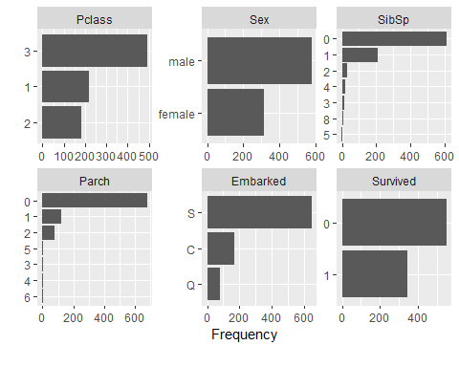
Machine Learning Statistics - Titanic Study
Outcome – survival (yes=1 or no=0,)
SibSp - number of siblings or spouse a passenger had
Parch - Number of parents/children/nanny aboard the Titanic
Embarked –Southampton, England
Cherbourg ,France
Queenstown,Ireland

Slide 9
Receiver Operating Characteristic Curve (ROC)
graphical plot that illustrates the diagnostic ability of a binary classifier system (survival/no survival) as its discrimination threshold is varied.
plot of the true positive rate (TPR) against the false positive rate (FPR) or 1-FPR at various threshold settings.

Slide 10
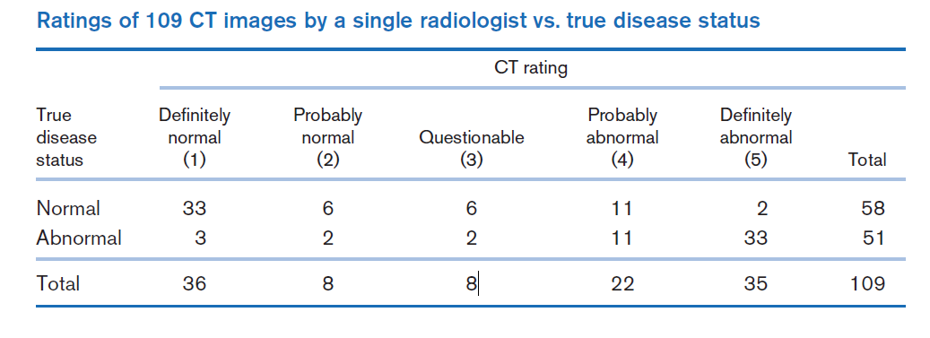
Classification Table with ROC Statistics
Table 3.3
Table 3.2 Rosner fundamentals of biostatistics, 5th ed
Sensitivity and specificity of the radiologist ratings according to different test-positive criteria based on the data in table 3.2
Test -positive criteria | Sensitivity | Specificity
1+ | 1.0 | 0
2+ | .94 | .57
3+ | .90 | .67
4+ | .86 | .78
5+ | .65 | .97
6+ | 0.0 | 1.0
Table 3.4 Take Away (apply what I have learned)
Example of sensitivity and specificity use by an individual patient
Actual condition | probability [radiologist is correct] = success = S | repeat test | calculations to increase accuracy are based on probability (failure) in individual tests | after repeats accuracy increases ------------------ probability (S) increases
Normal | (33+06)/58 = 66% ~ 67% ~ 2/3 | 3 x | (1/3)³ = 4% | 96%
Abnormal | (11+33)/51 = 86% | 2 x | (.14)² = 2% | 98%

Slide 11
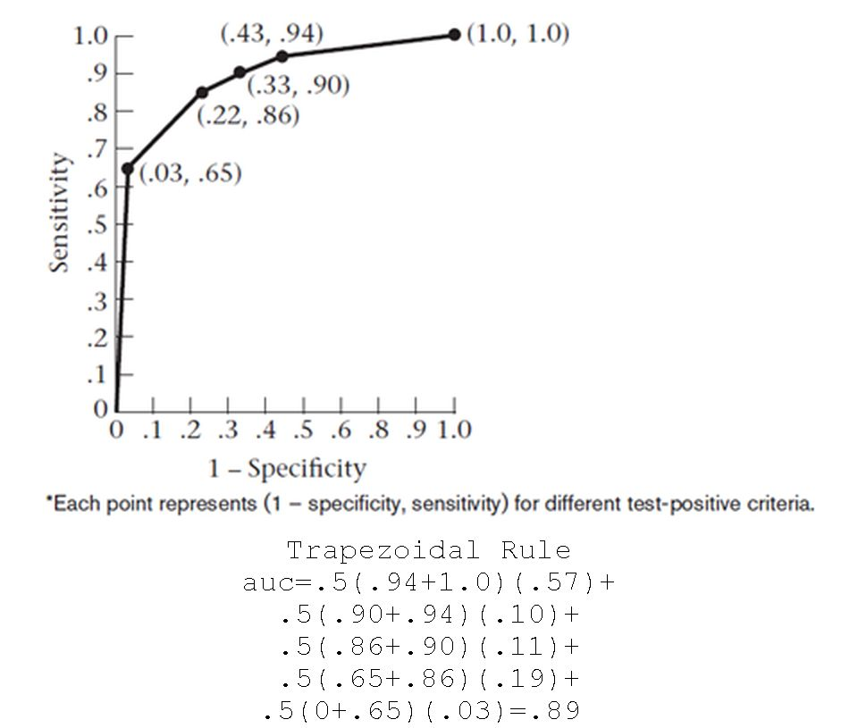
ROC Curve and the AUC
Roc curve -table 3.2
Curve points correspond to cutoff points used to designate test positive for a screening test.
AUC - the probability that the model will assign a larger probability to a random positive than a random negative observation. AUC=.89
the higher the AUC score, the more likely that correct predictions will be made by the radiologist.
Sensitivity = P[symptom| disease] = P[ +|+]
Specificity = P [no symptom |no disease] = P[ -| -]
1-Specificity = P [symptom | no disease] = P[+|-]

Slide 12
Trapezoidal Rule –auc computation details
auc=.5(.94+1.0)(1.0-.43)+
.5(.90+.94)(.,43-.33)+
.5(.86+.90)(.33-.22)+
.5(.65+.86)(.22-.03)+
.5(0+.65)(.03-0)=
auc=.5(1.94)(.57)+
.5(1.84)(.10)+
.5(1.76)(.11)+
.5(1.51)(.19)+
.5(.65)(.03)=
auc=.55290+.09200+.09680+.14345+.00975
=.89490

Slide 13
Summary
I am a bit nerdy, of straight sexual orientation, with a never-ending interest in what makes things work.
I constantly study to develop and improve statistically based
analytical approaches for problem solving.
I balance my work with an interest in equestrian events
and lap swimming.
I enjoy family gatherings and outings.

Slide 14
THE END
This icebreaker speech is a beginning for me.
I learned new skills in its preparation.
result - better future work products.
Thank you for your attention.
I hope you learned something new as well.

